Slide 1


ANNAI MIRA COLLEGE OF ENGINEERING AND TECHNOLOGY DEPARTMENT OF ELECTRONICS AND COMMUNICATION ENGINEERING
SMART E-DRIVEN UNIFORM FOR SOLDIER
GUIDED BY: DR. SRIVIDHYA, ASSOCIATE PROFESSOR / ECE
PRESENTED BY:
SANJAY BALA.A YOKESH RAJ.N
REG.NO;513521106033 REG.NO.513521106033

Slide 2
ABSTRACT
The Smart E-Uniform is designed to regulate a soldier’s body temperature and enhance safety in extreme environments. It uses an ESP8266 microcontroller, a temperature sensor, a metal detection sensor, and two relays to control a Peltier panel and a fan for heating and cooling.
Cooling Mode: When temperature increases, the fan turns ON.
Heating Mode: When temperature drops, the Peltier panel activates.
Safety Feature: The metal detection sensor alerts the soldier about harmful metal objects.
IoT Integration: Temperature and system status are displayed on an LCD and sent to a remote server for real-time monitoring.
This smart uniform enhances comfort, safety, and performance for soldiers in extreme conditions.

Slide 3
OBJECTIVE
To automate temperature regulation in soldiers' uniforms using a Peltier module and fan-based cooling.
To monitor real-time body temperature using a temperature sensor and display it on an LCD screen.
To enhance safety by integrating a metal detection sensor for alerting soldiers about nearby threats.
To enable remote monitoring of temperature conditions and alerts using IoT and ESP8266.
To improve soldier endurance in extreme weather conditions by maintaining an optimal body temperature.

Slide 4
INTRODUCTION
The extreme climatic conditions faced by soldiers in battlefields and remote locations can pose serious challenges to their health and performance. Traditional uniforms provide limited protection against extreme temperatures, making it essential to develop a Smart E-Uniform with automated temperature regulation and safety monitoring features.
This system integrates a temperature sensor, ESP8266 microcontroller, Peltier panel, fan, and metal detection sensor to actively regulate body temperature and enhance soldier safety. The temperature sensor continuously monitors body heat, triggering the Peltier module for heating when the temperature drops and the fan for cooling when it rises. Additionally, a metal detection sensor alerts soldiers to potential threats. The system is equipped with an LCD display for real-time data visualization and IoT connectivity for remote monitoring and alert notifications.

Slide 5
EXISTING SYSTEM
In the current scenario, soldiers rely on traditional military uniforms that provide only passive protection against environmental conditions. These uniforms are designed using insulating materials to offer some level of thermal regulation, but they lack active heating or cooling mechanisms to adapt to extreme temperatures.
For temperature regulation, soldiers often use additional layers of clothing in cold environments and lightweight fabrics in hot conditions, which can be ineffective and cumbersome. Moreover, metal detection and real-time health monitoring are not integrated, making soldiers vulnerable to hidden threats and environmental hazards.

Slide 6
PROPOSED SYSTEM
The Smart E-Uniform for Soldiers integrates temperature regulation, metal detection, and IoT-based monitoring to enhance soldier safety and comfort in extreme environments. The system uses a temperature sensor to monitor real-time body temperature and environmental conditions.
Adaptive Temperature Control:
If the temperature increases, the cooling fan is activated.
If the temperature decreases, the Peltier panel is activated for heating.
Two relay modules control the heating and cooling functions efficiently.
Metal Detection for Safety:
A metal detector sensor alerts the soldier about nearby metallic objects or weapons.
IoT-Based Monitoring and Alerts:
All real-time sensor data is displayed on an LCD screen.
The ESP8266 transmits data to an IoT-based system for remote monitoring and alerts.
This automated and real-time monitoring system enhances soldier comfort, safety, and situational awareness, making it highly effective for military applications.

Slide 7
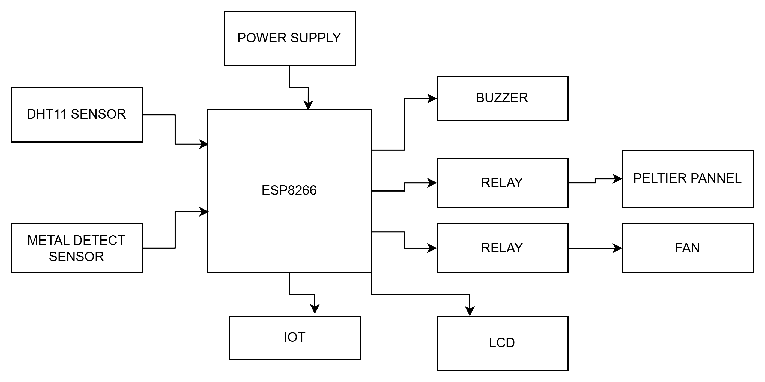
BLOCK DIAGRAM

Slide 8
HARDWARE REQUIREMENTS
Node MCU
DHT11
Metal detect sensor
Buzzer
Lcd
Peltier panel
Relay
fan

Slide 9
SOFTWARE REQUIREMENTS
Arduino ide
Embedded C

Slide 10
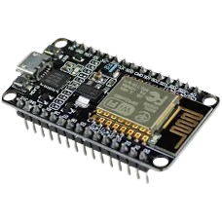
NODE MCU(ESP8266)
The ESP8266 is a low-cost, Wi-Fi-enabled microcontroller developed by Espressif Systems. It is widely used in IoT applications due to its built-in Wi-Fi capabilities, low power consumption, and compact size. The module can operate as a standalone microcontroller or as a Wi-Fi adapter for other microcontrollers via UART communication.

Slide 11
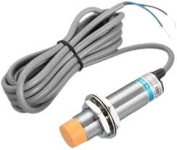
METAL DETECT SENSOR
A metal detector sensor is an electronic device designed to detect the presence of metallic objects in its proximity. It operates based on electromagnetic induction, where a coil generates an alternating magnetic field that induces currents in nearby metal objects. These induced currents create a secondary magnetic field, which is detected by the sensor, triggering an output signal.

Slide 12
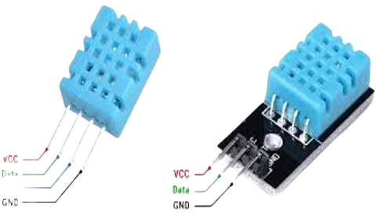
DHT11
The DHT11 is a low-cost digital sensor used to measure temperature and humidity in various embedded and IoT applications. It provides calibrated digital output and is easy to interface with microcontrollers like ESP8266, Arduino, and Raspberry Pi.

Slide 13
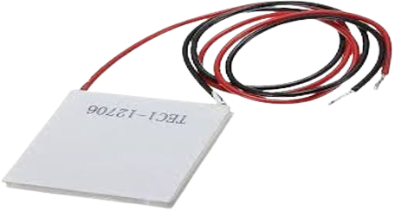
PELTIER PANEL
A Peltier panel, also known as a thermoelectric cooler (TEC), is a solid-state device that transfers heat using the Peltier effect. It functions as both a cooler and a heater, making it ideal for temperature control applications.

Slide 14
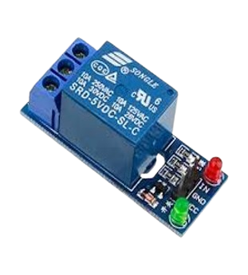
RELAY
A relay is an electromechanical switch used to control high-power devices with a low-power signal. It acts as an interface between the control circuit (microcontroller) and the load (such as a heater, motor, or fan).
Working Principle:
A small voltage signal from a microcontroller (ESP8266) activates an electromagnet inside the relay.
The electromagnet pulls a switch to either connect or disconnect the circuit.
This allows the relay to control high-voltage or high-current devices using low-voltage logic.

Slide 15
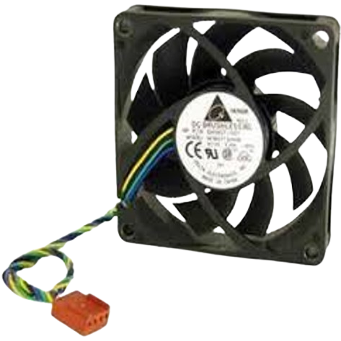
FAN
A fan is an electromechanical device that generates airflow by rotating blades, commonly used for cooling and ventilation. It works on the principle of converting electrical energy into mechanical energy using a motor.
Working Principle
When power is supplied, the motor inside the fan starts rotating.
The blades attached to the motor move air, creating a cooling effect.
The airflow depends on the fan speed, blade design, and motor power.

Slide 16
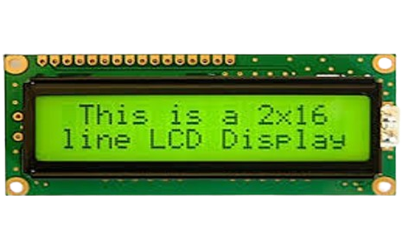
LCD
An LCD (Liquid Crystal Display) is an electronic display module commonly used in embedded systems to display alphanumeric characters, sensor values, and system status. It operates by manipulating liquid crystals to control light passage.

Slide 17
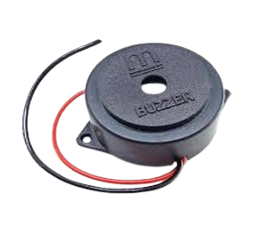
BUZZER
A buzzer is an electronic sound-producing component commonly used in embedded systems for alarms, notifications, and alerts. It converts electrical signals into sound waves, making it useful for warning systems, security alerts, and status notifications.

Slide 18
CONCLUSION
The Smart e-Uniform for Soldiers provides an innovative and automated solution for monitoring and regulating body temperature in extreme environmental conditions. By integrating a temperature sensor, ESP8266 controller, metal detection sensor, relays, a Peltier panel, and a fan, the system effectively maintains thermal comfort for soldiers. The cooling and heating mechanisms ensure that soldiers remain comfortable in both hot and cold environments. Additionally, real-time temperature data is displayed on an LCD and transmitted via IoT for remote monitoring and alerts.

Slide 19
FUTURE SCOPE
AI-Based Adaptive Control – Implementing machine learning algorithms to predict and adjust temperature settings dynamically based on environmental conditions and soldier activity.
Energy-Efficient Power Management – Optimizing power consumption using low-power components or integrating solar charging for extended battery life.
Wearable Health Monitoring – Adding sensors for heart rate, oxygen levels, and stress detection to enhance soldier safety and health tracking.
Smart Fabric Integration – Embedding flexible sensors and conductive textiles for improved durability, comfort, and seamless integration.
Advanced Communication Features – Enhancing IoT capabilities for real-time soldier health monitoring and remote data transmission to command centers.

Slide 20


Slide 21


